Slide 1

Uber Data Analysis
Dashboard
Presented By
Ankita Kheto
Total Rows
150,000
Total Columns
17
Data Source
Kaggle –Uber Dataset

Slide 2
Introduction
Background of the dataset:
.
The dataset contains Uber ride booking information including ride status, vehicle type, revenue, payment method, riders, and drivers.
It represents real-world ride activity and helps analyze operational and customer behavior patterns.
.
Significance of the study:
.
This study is significant because it transforms raw Uber ride data into meaningful insights using Power BI. It helps stakeholders understand booking trends, revenue patterns, vehicle performance, and customer behavior in a simple and visual way. The dashboard supports better decision-making by highlighting key performance areas, identifying issues like cancellations, and improving overall operational efficiency.

Slide 3
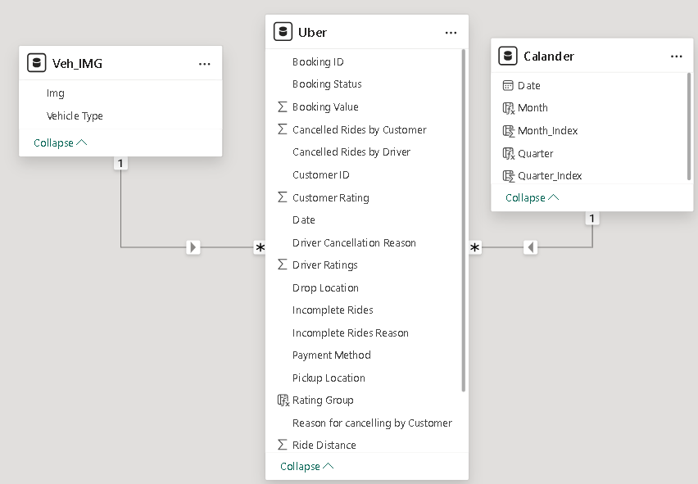
Problems statement
.
Uber generates large volumes of ride and revenue data which is difficult to analyze in raw form.
.
There is no single view to monitor key performance indicators like total rides, revenue, riders, and drivers.
.
Understanding vehicle-wise performance and customer preferences is challenging without proper visualization.
.
Identifying revenue trends and popular payment methods is not easy using raw data.
.
Booking cancellations and performance issues cannot be effectively tracked without an analytical dashboard.
Data Modeling
One-to-Many relationships are created between Vehicle IMG and Uber, and Calendar and Uber, where Uber acts as the fact table.

Slide 4
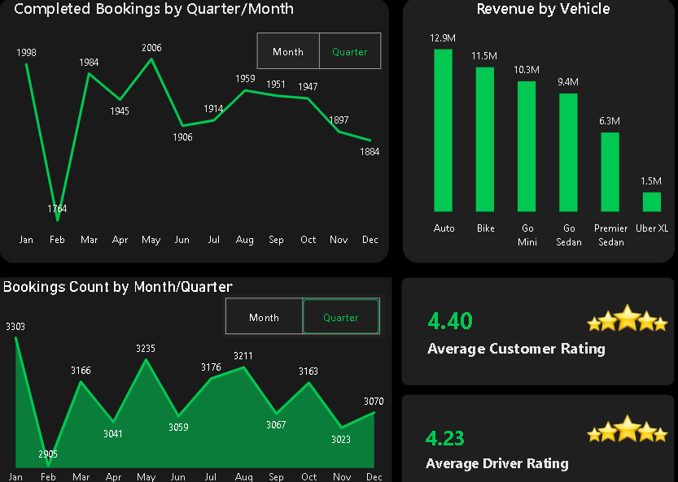
Overview Dashboard
KPI
Completed Bookings
Total 23K bookings successfully completed, showing strong service usage and demand.
Lost Bookings
14K bookings were lost, indicating opportunities to improve availability and conversion.
Revenue
The platform generated 13M total revenue, reflecting overall business performance.
Total Distance
Vehicles covered 625.62K km, showing high operational activity.
Average Distance
Average trip distance is 24.62 km, indicating medium to long trips.
Charts
Completed Bookings (Month/Quarter)
Bookings peaked in May/Q2 and declined towards the end of the year, with February/Q4 being the lowest.
Bookings Count (Month/Quarter)
Highest booking volume is observed in May/Q3, while a drop is seen during September to November.
Revenue by Vehicle
Auto and Bike generate the highest revenue, while Uber XL contributes the least.
Customer Rating
Average customer rating is 4.40, indicating high customer satisfaction.
Driver Rating
Average driver rating is 4.23, showing good driver performance.

Slide 5
Vehicle Dashboard
KPI
Completed Bookings
Total 23K bookings successfully completed, showing strong service usage and demand.
Lost Bookings
14K bookings were lost, indicating opportunities to improve availability and conversion.
Revenue
The platform generated 13M total revenue, reflecting overall business performance.
Total Distance
Vehicles covered 625.62K km, showing high operational activity.
Average Distance
Average trip distance is 24.62 km, indicating medium to long trips.

Slide 6
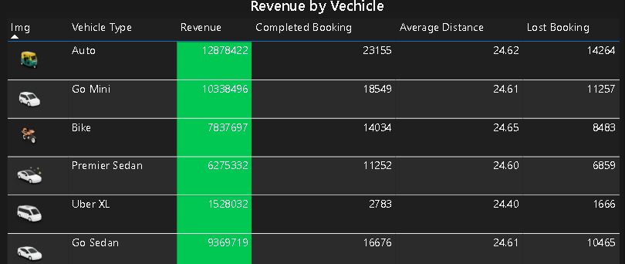
Vehicle Dashboard
Charts
Lost Bookings By Vehicle
Booking Value (Revenue)
Auto also shows higher lost bookings due to high demand . Go Mini and Go Sedan have moderate lost bookings . Bike has comparatively fewer lost bookings . Uber XL has the lowest lost bookings because of low demand.
Auto has the highest booking value, making it the top revenue contributor . Go Mini and Bike also generate strong revenue . Premier Sedan has moderate revenue . Uber XL generates the lowest booking value.
Average Distance By Vehicle
Completed Bookings By Vehicle
Average trip distance is almost same (~24–25 km) across all vehicle types . Bike and Auto show slightly higher average distance . Uber XL has the lowest average distance
Auto has the highest number of completed bookings . Go Mini and Bike show good booking completion . Go Sedan and Premier Sedan have moderate completed bookings . Uber XL has the least completed bookings.

Slide 7
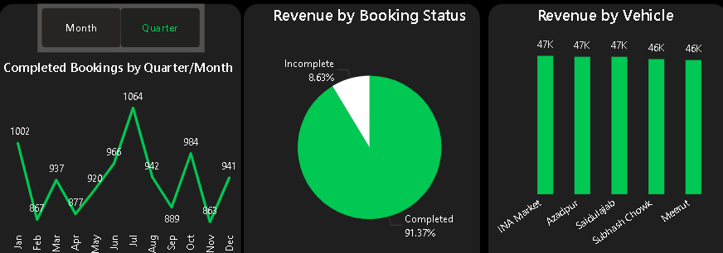
Revenue Dashboard
Charts
Completed Bookings by Month
Completed Bookings by Quarter
Bookings are high in January, drop in February . Peak completed bookings observed in mid-year months (May–July).
Bookings are lowest in Q2 .Q3 shows the highest completed bookings . Slight decline observed in Q4.
Revenue by Booking Status
Revenue by Vehicle
91.37% revenue comes from completed bookings . Only 8.63% revenue is from incomplete bookings, showing high completion efficiency.
Revenue contribution is almost evenly distributed across vehicles . Each vehicle generates around 46K–47K revenue.

Slide 8
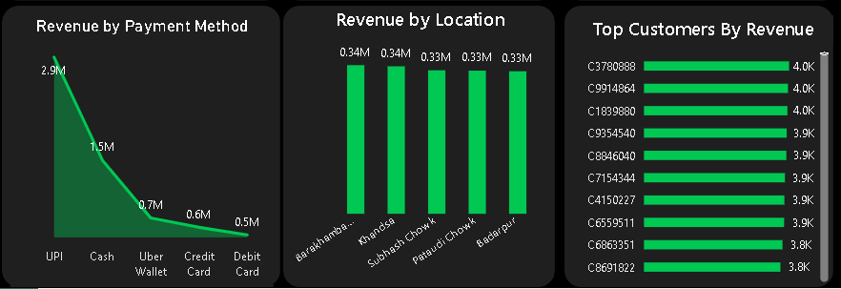
Revenue Dashboard
Charts
Revenue by Payment Method
Revenue by Location
UPI is the most used payment method with highest revenue . Cash and Uber Wallet show moderate usage . Credit and Debit Cards are least used.
Revenue is evenly distributed across all locations.No single location dominates revenue generation.
Top Customers by Revenue
Top customers contribute around 3.8K–4.0K revenue each . Revenue is well distributed, not dependent on one customer.

Slide 9
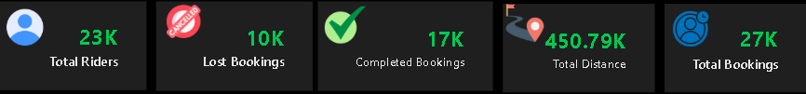
Rider Dashboard
KPI
Total Riders
This KPI shows the total number of unique riders using the platform . It helps measure the overall customer base and user growth.
Total Bookings
Represents the total number of ride bookings made by riders . It indicates overall demand and platform usage.
Completed Bookings
Shows the number of rides successfully completed . It reflects service efficiency and customer satisfaction.
Total Distance
Shows the total distance traveled across all completed rides . It helps understand ride activity and revenue potential.
Lost Bookings
Indicates bookings that were cancelled or not completed . This helps identify drop-offs and operational issues.

Slide 10
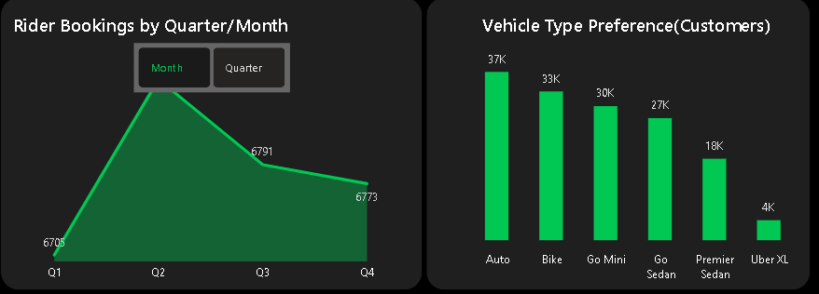
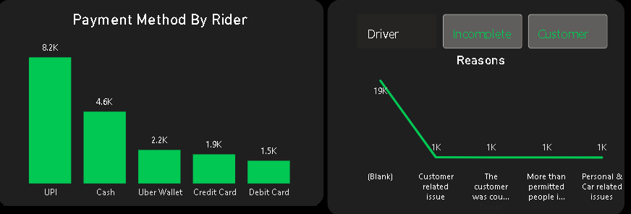
Revenue Dashboard
Charts
Booking Trend by Month and Quarter
Rider Payment Method Distribution
This parameter allows analysis of booking trends over different time intervals. Users can switch between monthly and quarterly views. It helps identify seasonal demand patterns. This flexibility improves trend analysis.
Payment Method identifies how riders pay for their trips. Options include UPI, Cash, Wallet, Credit Card, and Debit Card. It helps analyze payment behavior and digital adoption. This insight is useful for financial strategy planning.
Customer Preference by Vehicle Type
Incomplete and Driver , customer cancel Reason
Vehicle Type categorizes rides based on service options such as Auto, Bike, Sedan, and XL. It helps understand customer preferences across vehicle categories. This parameter supports fleet planning and demand optimization. It also highlights popular ride types.
Driver cancellations usually occur because of vehicle or personal issues, while customer cancellations happen due to confusion, plan changes, or policy violations. Understanding these reasons helps improve operational efficiency and reduce booking failures.

Slide 11
Conclusion
The analysis shows that completed bookings are significantly higher than lost bookings, indicating strong operational efficiency, though cancellations still need attention.
Auto, Bike, and Go Mini generate the highest number of bookings and revenue, proving that customers prefer affordable and short-distance ride options.
UPI is the most preferred payment method, highlighting strong adoption of digital payments, while card-based payments are used less frequently.
Most incomplete bookings are caused by customer-related and unspecified reasons, suggesting the need for better communication and clearer booking guidelines.
Revenue and booking trends vary by time period and vehicle type, which can help the business optimize pricing, fleet allocation, and promotional strategies.

Slide 12
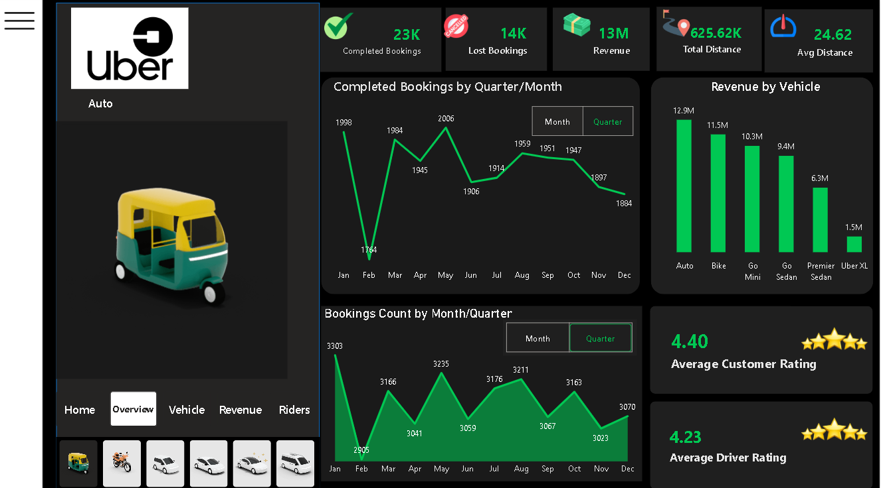
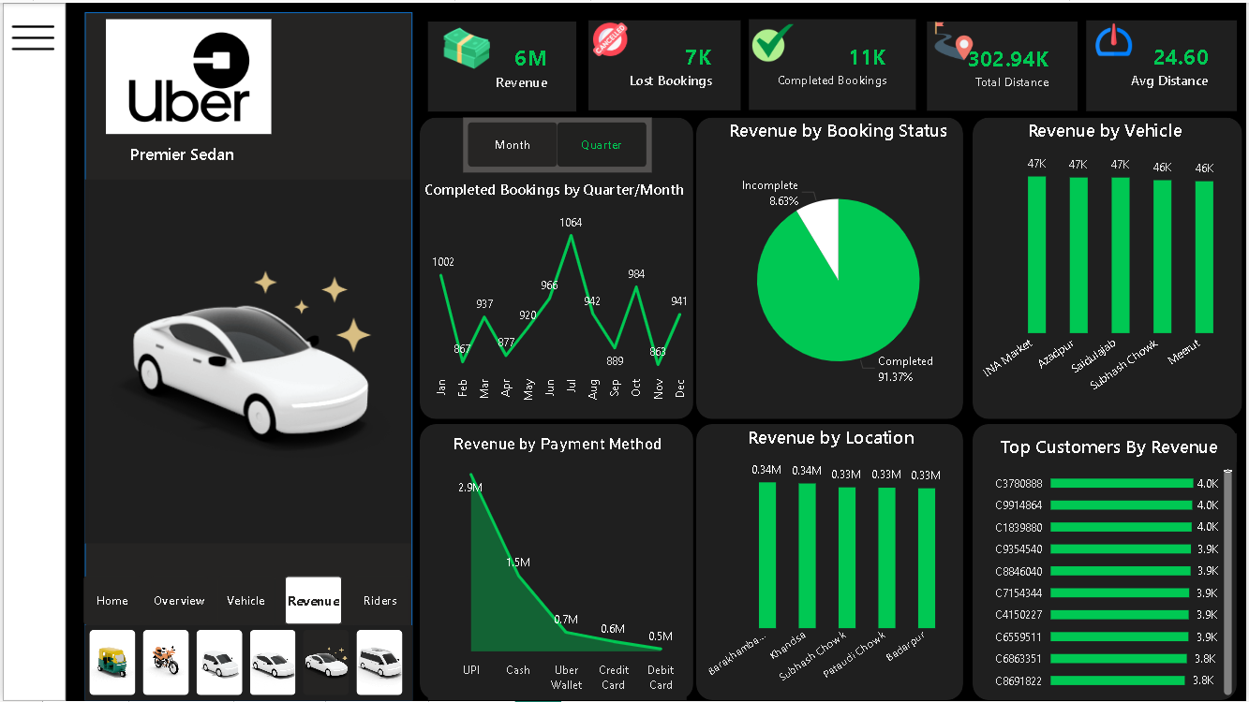
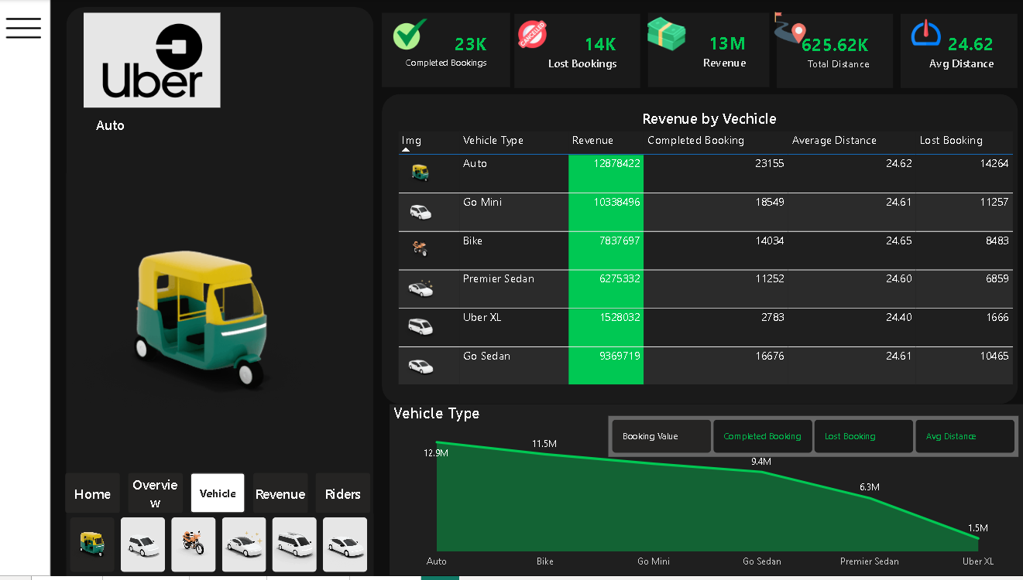
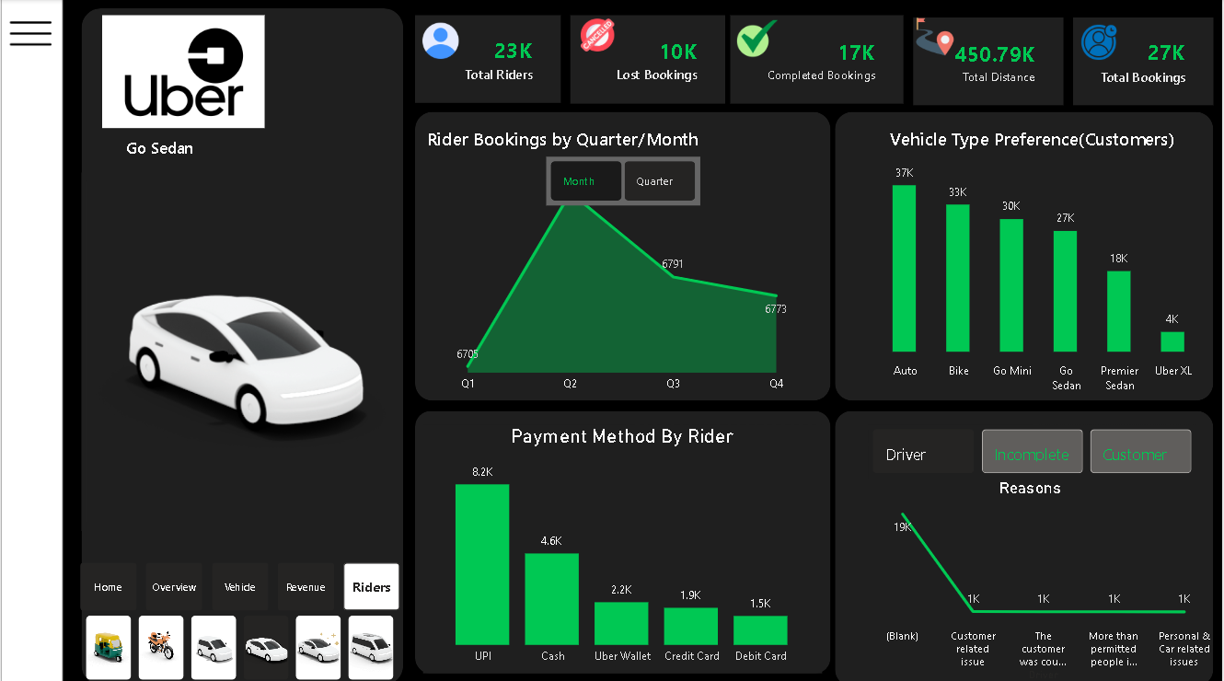
Dashboard
Thank you

